Slide 1
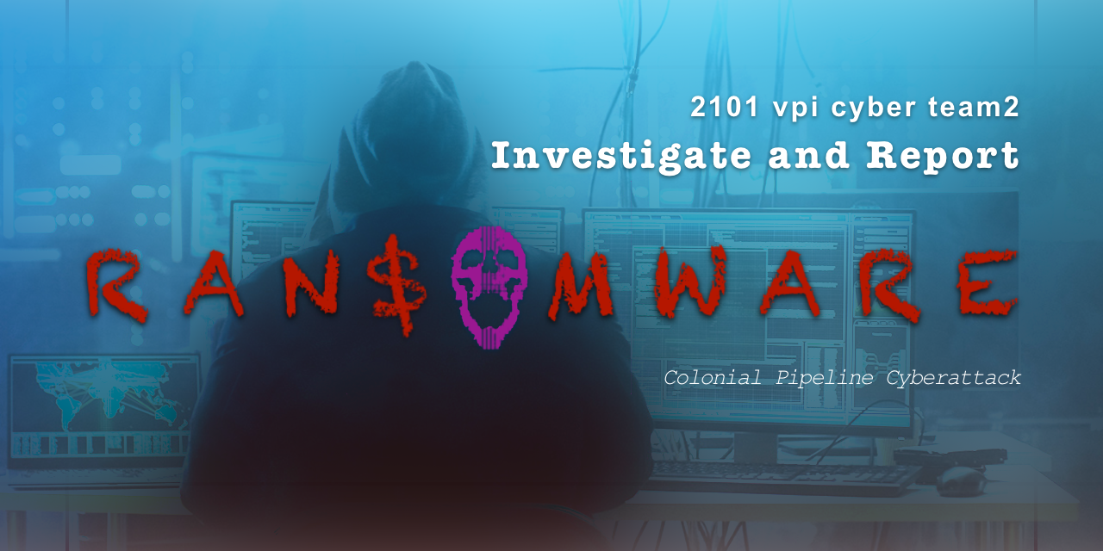

Slide 2

Kim Y.
Background
Decisions
Impacts

Slide 3
Background
The Colonial Pipeline is the largest in the US
Darkside is a criminal hacker group, thought to be based in eastern Europe

Slide 4

Decisions
Shutting Down the Pipeline…
the company didn’t know how much access the hackers might gain, maintaining operational control of the pipeline was paramount
to prevent hackers from migrating to the pipeline control system, Colonial decided a complete shutdown was necessary
Paying the Ransom…
wanted to get the pipeline back online as quickly as possible
wanted to keep the situation confidential

Slide 5
Impacts
panic buying
inventory reduction
opportunity cost
expectation management
increased regulation and inspection

